Slide 1
Introduction to Electric Power System and A. C. Supply

Slide 2
Course outcome
C403.1 : Determine electrical quantities of AC supply and circuit parameters of R-L and R-C circuits.

Slide 3
Introduction
In the day to day life, we use electrical power for various applications including the domestic & industrial applications.
For most of the domestic applications, we use a single phase ac supply.
For high power industrial applications, the three phase ac supply is used.
For certain domestic applications such as telephones, the dc supply is used.
For certain applications such as electric trains, a high voltage DC system is used.

Slide 4
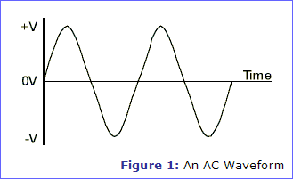
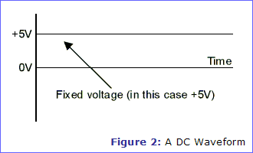
Difference between AC & DC Quantities
Sr. No. | Parameter | AC | DC
1. | Waveform
2. | Definition | It is a signal which changes its magnitude as well as polarity. | It is a signal which changes its magnitude but does not change its polarity.
3. | Use of transformer | Possible | Not possible
4. | Distribution efficiency | High | Low

Slide 5
Continued…
Sr. No. | Parameter | AC | DC
5. | Design of machines | Easy | Not easy
6. | Generation | Easy | From the ac waveform using commutator or rectifier
7. | Applications | AC motors, domestic & industrial supply etc. | DC machines, HVDC system

Slide 6
Electrical Power Supply System
The electrical power supply system can be subdivided into three subsystems, as follows:
1. Generation system.
2. Transmission system.
3. Distribution system.
The electrical energy generated by the generating system is transmitted to the load centres by the transmission system. This energy is then distributed to the distribution system.

Slide 7
Generating System
The function of generating system is to generate electrical energy.
The input to such a system may be thermal energy, hydro-energy or nuclear energy.
The generating systems are broadly classified into two types:
1. conventional system
2. Non-conventional system

Slide 8
Conventional System
Conventional generating systems are those which take non-renewable source of energy as the raw material. The conventional systems are classified as follows:
Thermal system:
Converting heat energy of fuels like coal, petrol etc. into electrical energy.
Hydroelectric system:
Converting potential energy of stored water into electrical energy.

Slide 9
Continued…
3. Nuclear system:
Converting heat obtained by nuclear fission reaction into electrical energy.
4. Diesel electric system:
Converting energy stored in diesel into electrical energy.

Slide 10
Non-conventional System
Non-conventional systems are those which use renewable source of energy as the input.
The non-conventional systems are classified as follows:
1. Solar energy 2. Wind energy
3. Tidal energy 4. Energy from biogas etc.

Slide 11
Extra High Voltage Transmission System (EHVAC)
The increased demand of electricity needs more generation of electrical power. As the generation takes place at remote places, an efficient distribution system is necessary.
Fig. 1. shows the simplified block diagram of the extra high voltage AC transmission system.
This system can be broadly divided into two parts:
a. Transmission system.
b. Distribution system

Slide 12
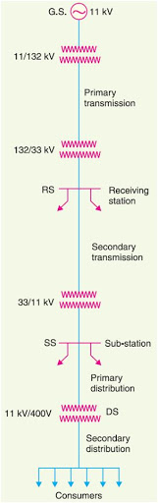
Step up transformer
132 kV
Step down transformer
33 kV
33 kV
400/230V
Fig. 1: Basic EHVAC system

Slide 13
Transmission System
Transmission system is further divided as:
1. Primary Transmission
2. Secondary Transmission.
Primary Transmission:
As shown in fig. central station/ generation system generates power using three phase alternators at 6.6/11/13.2/32kV.
This voltage is then stepped up by suitable three phase transformer, to 132 KV.
This voltage is stepped down to 33 kV using step down transformer which is at receiving station.

Slide 14
Continued…
2. Secondary Transmission:
From receiving station, power is then transmitted at 33 kV by underground cables to various substations (ss) located at various points in the city.
This known as secondary or low voltage transmission.
At the substations, this voltage is further reduced from 33kV to 3.3/11kV, using step down transformer.

Slide 15
Distribution System
Distribution system is further divided as:
1. Primary Distribution
2. Secondary Distribution.
Primary Distribution:
The output of substation at 3.3/11 kV can be directly given to a customer whose demand exceeds 50 kVA using special feeders. This is primary distribution.

Slide 16
Continued…
2. Secondary Distribution:
The secondary distribution is done at 440/400/230 V.
The reduction in the voltage level from 3.3kV to 400/230 V is done by the step down transformer at the distribution substations.

Slide 17
Types of Transmission & Distribution System
The transmission & distribution systems are classified as:
1. AC System
2. DC System.

Slide 18
AC Power Transmission
AC power transmission is the transmission of electric power by alternating current.
Usually the transmission lines are three phase AC current, whereas, in electric railways, single phase AC current is sometimes used for railway rectification system.

Slide 19
Advantages of AC System
High voltage can be built-up.
The fluctuation in the voltage level as per requirement can be done using step-up and step-down transformers.
Maintenance cost of substations and generation cost of AC voltage is low.
The motors used are simple in construction & have low maintenance.
Maintenance of substation is cheap.

Slide 20
Disadvantages of AC Systems
The initial set up is very expensive.
The resistance offered by the lines is high which cause skin effect and thus leading to voltage drop.
The AC lines are more sensitive to corona.
The AC lines even show losses due to reactance offered by the line.
The speed of alternator requires to be controlled.

Slide 21
DC Power Transmission
For many reasons power is generated, transmitted, distributed and consumed as an alternating current. But, if certain applications need the use of DC, the AC was converted to DC locally by motor generator sets, rotary converted to DC locally by motor generator sets, rotary convertors etc.
There are certain advantages or technical reasons too associated with the DC system, which are as follows:
1. Due to large charging currents, the use of high voltages AC for underground transmission over longer distance is prohibited. But, for DC there is no such limitations.

Slide 22
Continued…
2. Parallel operations of AC with DC increases the stability limits of the system.
A DC transmission line requires converters at each end, i.e. at the sending end where AC is converted into DC and at receiving end where DC is again converted to AC for use.

Slide 23
Advantages of DC Transmission
The line construction is simple. Hence, the line is cheaper as compared to AC.
The power per conductor of DC is more as compared with AC.
There is no charging current required because of which the length of transmission is not limited and the cable need not be derated.
The DC line is cheaper & simpler as it requires two conductors instead of three.
High operating voltages possible.
No stability problem.

Slide 24
Disadvantages of DC Transmission
Expensive converters.
The power transmitted can be used at lower voltage only.
Voltage transformation is not easier in case of DC and hence it has to be done on the AC side of the system.
Circuit breaking for multi-terminal lines is difficult.

Slide 25
Applications of DC Transmission
Long distance bulk power transmission.
Under ground or under water cables.
A synchronous interconnection of AC system operating at different frequencies or where independent control of systems is desired.

Slide 26
Battery as DC Supply
For many applications, we need to use a low voltage DC source. The “battery” is used as DC power supply for such applications.
The batteries can be of different types as:
1. Lead acid battery. 2. Nickel cadmium battery.
3. Dry battery. 4. Maintenance free battery.

Slide 27
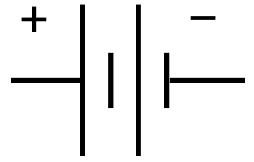
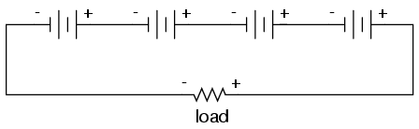
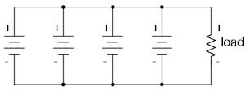
Continued…
V
v1 v2 v3 v4
(a) Symbol
(b) Batteries in series
v1
v2
v3
v4
(c) Batteries in parallel

Slide 28
Continued…
Fig. (a) shows the symbol of a battery.
As shown in fig. (b), we can connect batteries in series so as to increase the terminal voltage whereas they can be connected in parallel as shown in fig. (c) so as to increase the current sourcing capacity.
Applications:
Torch
Radio, music system, laptop, computers.
Cars, two wheelers & other vehicles.
UPS system.

Slide 29
Utilization of Electrical Power
The electrical power has number of applications or utilization areas . It is used in domestic as well as industrial applications.
Following are some of the applications of electrical power:
Domestic applications such as lighting, fans, heaters, irons, TV etc.
AC & DC motor drives.
Machine tool applications.
Electrically operated vehicles, trains, cars.
Welding
Induction heating & dielectric heating.
Electroagro systems.

Slide 30
AC Fundamentals

Slide 31
AC Supply System
The electric supply used for the domestic applications is single phase ac supply whereas that used for the factories, institutions etc. is a three phase ac supply.
The single phase ac supply is a two wire system, the two wires involved are called “Phase” and “Neutral.’’

Slide 32
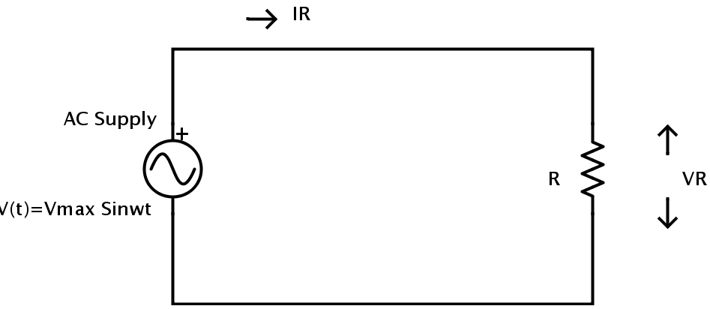
Continued….

Slide 33
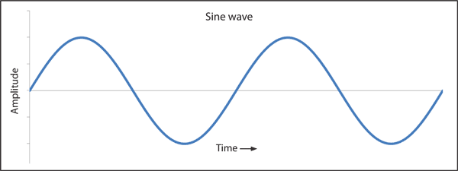
AC Waveforms
Waveform:
A waveform is a graph of magnitude of a quantity with respect to time.
The quantity plotted on the X-axis is time and the quantity plotted on the Y-axis will be voltage, current, power etc.

Slide 34
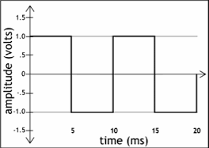
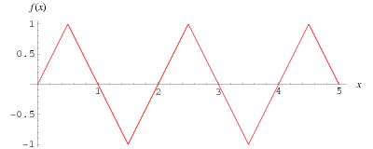
Continued….
Types of AC Waveforms:
The shape of an ac quantity need not always be a sine wave.
It can have other shape such as triangular wave, square wave or a trapezoidal waveform.
(a) Square wave
(b) Triangular wave

Slide 35
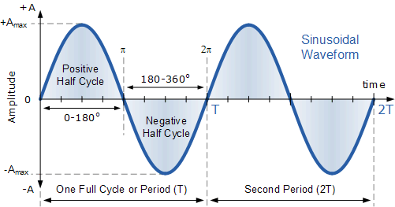
Graphical & Mathematical Representation of Sinusoidal AC Quantities
Fig. 1: Instantaneous sinusoidal voltage/ current

Slide 36
Continued….
Mathematical representation:
The voltage wave form is mathematically represented as,
v(t) = V_{m} sin(2πf₀t) ……(1)
Where v(t) = Instantaneous voltage,
V_{m} = Peak value (or maximum value)
f₀ = Frequency in Hz. (f₀ = 1/T₀)
and “sin” represents the shape of the waveform.

Slide 37
Continued….
It can also be represented as,
v(t) = V_{m} sin (ω₀t) or V_{m} sinθ
where θ = ω₀t = 2πf₀t
Similarly the current waveform is mathematically represented as,
i(t) = I_{m} sin(2πf₀t)
Where i(t) = Instantaneous current,
I_{m} = Peak value (or maximum value)
f₀ = Frequency in Hz.

Slide 38
Definitions
Waveform:
The waveform is a graph of magnitude of an AC quantity against time. The waveform tells us about instantaneous (instant to instant) change in the magnitude (value) of an AC waveform.
Instantaneous value:
The instantaneous value of an ac quantity is defined as the value of that quantity at particular instant of time.

Slide 39
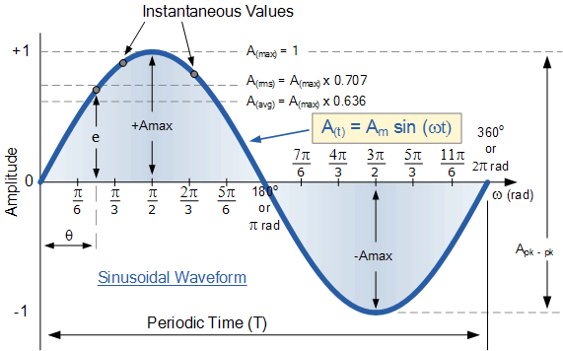
Continued….
Fig. (a) Waveform & instantaneous value of an ac voltage
Fig. (b) Definition of cycle & time period

Slide 40
Continued….
3. Cycle:
In an ac waveform, a particular portion consisting of one positive and negative part repeats many times. Each repetition consisting of one positive & one identical negative part is called as one cycle of the waveform as shown in fig.(b).
If the waveform is plotted by plotting angle on the X-axis in place of time, then cycle is that portion of the waveform corresponding to the angle span of 2 π radians as shown in fig. (a).
1 cycle ≅ 2 π radians = 360⁰

Slide 41
Continued….
4. Time Period or Periodic Time (T):
Time period (T) is defined as the time taken in seconds by the waveform of an ac quantity to complete one cycle. After every T seconds, the cycle repeats itself as shown in fig.(b).
5. Frequency:
Frequency is defined as the number of cycles completed by an alternating quantity in one second. It is denoted by “f” and its units are cycles/second or Hertz (Hz).

Slide 42
Continued….
cycles
Frequency (f) =
= 1
seconds
Second/cycle
∴ f = (1/T)Hz
Therefore as the time period increases, the frequency decreases and vice-versa as shown in fig.(c)

Slide 43
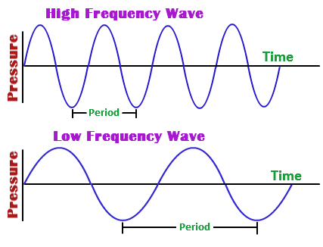
Continued….
Fig. (c) : effect of change in time period (T) on the value of frequency

Slide 44
Continued….
6. Amplitude:
The maximum value or peak value of an ac quantity is called as its amplitude. The amplitude is denoted by V_{m} for voltage, I_{m} for current waveform etc.
7. Angular Velocity (ω):
The angular velocity (ω) is the rate of change of angle ωt with respect to time.
∴ ω = dθ ……(1)
where dθ is the change in angle in time dt.
dt

Slide 45
Continued….
If dt = T i.e. time period, (one cycle) then the corresponding change in θ is 2 π radians.
∴ dθ = 2π
∴ ω = 2π …..(2)
But 1/T = f
∴ ω = 2πf
T

Slide 46
Peak and Peak to Peak Voltage
Peak to peak values are most often used when measuring the magnitude on the cathode ray oscilloscope (CRO) which is a measuring instrument.
Peak voltage is the voltage measured from baseline of an ac waveform to its maximum or peak level. It is also called as amplitude.
Peak voltage is denoted by V_{m} or V_{p}.
Peak to peak voltage is the voltage measured from the maximum positive level to maximum negative level.
Peak to peak voltage is denoted by V_{p-p}.
∴ V_{p-p} = 2 V_{m}

Slide 47
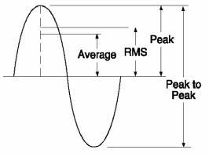
Continued….
fig. 1: Peak and peak to peak value

Slide 48
Effective or R.M.S. Value
The effective or RMS value of an ac current is equal to the steady state or DC current that is required to produce the same amount of heat as produced by the ac current provided that the resistance and time for which these currents flow are identical.
RMS value of ac current is denoted by I_{rms} and RMS voltage is denoted by V_{rms}.
RMS value of a sinusoidal waveform is equal to 0.707 times its peak value.
I_{rms} = 0.707 I_{m}

Slide 49
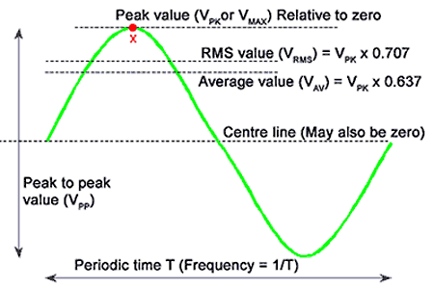
Continued….
RMS value is called as the heat producing component of ac current.
Fig. 1: Effective or RMS value & average value of ac waveform

Slide 50
Average Value
The average value of an alternating quantity is equal to the average of all, the instantaneous values over a period of half cycle.
The average value of ac current denoted by I_{av} or I_{dc}.
The average value of a sinusoidal waveform is 0.637 times its peak value as shown in fig.1.
I_{av} = I_{dc} = 0.637 I_{m}

Slide 51
Form Factor
The form factor of an alternating quantity is defined as the ratio of its RMS value to its average value.
∴ Form factor K_{f} =
Form factor is dimensionless quantity and its value is always higher than one.
Form factor of a sinusoidal alternating quantity is given by,
K_{f} = I_{rms} = 0.707 I_{m} = 1.11
RMS value
Average value
I_{av}
0.637 I_{m}

Slide 52
Crest Factor or Peak Factor (K_{p})
The maximum value (peak value or amplitude) of an alternating quantity is called as the crest value of the quantity.
The crest factor is defined as the ratio of the crest value to the rms value of the quantity.
∴ K_{p} =
For a sinusoidal alternating quantity the crest factor is given by,
K_{p} = √2 x RMS value = 1.414
Peak value
RMS value
RMS value

Slide 53
Phasor Representation of an AC Quantity
A phasor is a straight line with an arrow marked on one side.
The length of this straight line represents the magnitude of the sinusoidal quantity being represented and the arrow represents its direction.
Direction of Rotation
Length represents magnitude
Reference axis
Fig.1: Phasor representation of a sinusoidal quantity

Slide 54
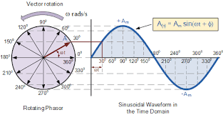
Continued….
Fig. (2): Relation between an alternating quantity and phasor

Slide 55
Phase of an Alternating Quantity
Phase angle:
The equation of the induced emf in the conductor is
v = V_{m} sin ωt = V_{m} sinθ …… (1)
In equation (1), θ is the angle made by the conductor with the reference axis & it is called as the Phase Angle.

Slide 56
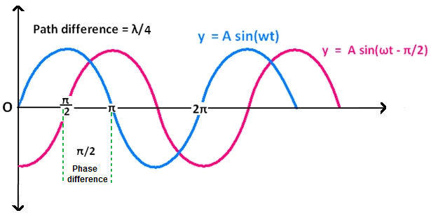
Continued….
Phase Difference:
It is not necessary that two voltages or current waves originate at the same instant of time.
V_{B}
V_{A}
Fig.1.: Concept of phase difference

Slide 57
Continued….
As shown in fig. 1, two waves do not have the same zero crossover point so, we say that there is a phase difference between them.
Both V_{A} and V_{B} have the same frequency & same peak voltage.
We can represent two voltages mathematically as follows:
V_{A} = A sin ωt
V_{B} = A sin (ωt – π/2 )
V_{B} = A sin (ωt – ø ) (ø = π/2 ) ……..(2)
The angle π/2 is known as the phase difference between V_{A} and V_{B}.
Phase difference can take any value between 0 and 2π.

Slide 58
Continued….
Leading and Lagging Phase Difference:
Leading phase difference:
If the phase angle ø in equation (2) is positive then the phase difference ø is said to be a leading phase difference. In other words, we say that voltage V_{B} leads the voltage V_{A}.
2. Lagging phase difference:
If the phase angle ø in equation (2) is negative, then the phase difference is said to be a lagging phase difference. That means V_{B} lags behind V_{A} by ø.

Slide 59
Representation of AC Quantity in Rectangular & Polar Form
A phasor can be presented in two different ways:
1. Rectangular form
2. Polar form.
The instantaneous voltage
v(t) = V_{m} sin (ωt + ø) ……(1)
is represented using a phasor as shown in fig.1

Slide 60
Continued….
From fig.1, we can obtain the expression for the polar and rectangular forms.
V_{m}
r
y = V_{m} sin ø
ø
x = V_{m} cos ø
Fig. 1

Slide 61
Continued….
Polar Representation:
The equation (1) can be represented in the polar form as follows:
v(t) = r ∠ ø ……..(2)
where r = V_{m.}
That means length of phasor (r) represents the peak value of the ac quantity.
The polar form is suitable for multiplication and addition of phasors.

Slide 62
Continued….
2. Rectangular Representation:
The equation (1) can be represented in the rectangular form as follows:
v(t) = x + jy ……(3)
where x = x component of the phasor = V_{m} cos ø
y = y component of the phasor = V_{m} sin ø
Substituting the values of x and y components into equation (3), we get,
v(t) = V_{m} cos ø + j V_{m} sin ø …..(4)
Rectangular form is suitable for addition & subtraction of phasors.

Slide 63
Single Phase AC Circuits
The three basic elements of any ac circuit are Resistance (R), Inductance (L), and capacitance (C).
The three basic circuits are:
Purely resistive AC circuit.
Purely inductive AC circuit.
Purely capacitive AC circuit.

Slide 64
Continued….
Reactance:
Reactance can be of two types:
1. Inductive reactance X_{L}.
2. Capacitive reactance X_{C}.
Inductive reactance (X_{L}):
We define the inductive reactance X_{L} as,
X_{L} = ω_{L} = 2πfL and the unit is ohm (Ω ).
We can define inductive reactance as the opposition to the flow of an alternating current, offered by an inductance.

Slide 65
Continued….
2. Capacitive Reactance (X_{C}):
We define the capacitive reactance X_{C} as,
X_{C} =
1
=
1
…….(1)
ωC
2πfC
The unit of capacitive reactance is ohm (Ω).
Thus capacitive reactance X_{C} is defined as the opposition offered by a pure capacitor to the flow of alternating current.
Equation (1) shows that the capacitive reactance is inversely proportional to the frequency of the applied voltage if C is constant.

Slide 66
Continued….
Impedance:
The ac circuit may not always be purely resistive, capacitive or inductive. It will contain the combination of these elements.
so defining resistance and reactance is not enough.
Hence a combination of R, X_{L} and X_{C} is defined and it is called as impedance.
Impedance is denoted by Z and has unit Ω

Slide 67
Continued….
Impedance can be expressed in polar form as follows:
Z = |Z| ∠ ø
where |Z| = magnitude of Z,
ø = phase angle.
And it is expressed in rectangular form as,
Z = R + jX
where |Z| = √(R² + X²) and ø = tan⁻¹[X/R]

Slide 68
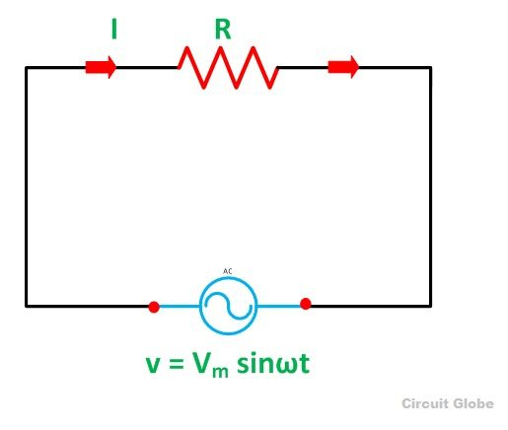
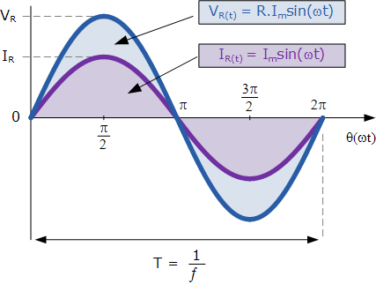
Purely Resistive AC Circuit
The purely resistive ac circuit is as shown in fig. 1(a). It consists of an ac voltage source
v = V_{m} sin ωt, and a resistor R connected across it.
Fig. 1(a): Purely resistive ac circuit
Fig. 1(b): Voltage and current waveform

Slide 69
Continued….
Voltage and Current Waveform and Equation:
Referring to fig. 1(a), the instantaneous voltage across the resistor (v_{R}) is same as the source voltage.
∴ v_{R} = v = V_{m} sin ωt …..(1)
Applying the ohm’s law the expression for the instantaneous current flowing through the resistor is given by,
v_{R} V_{m} sin ωt V_{m} ∠ 0⁰
i =
=
=
R
R
R ∠ 0⁰
Let I_{m} = V_{m} , I = I_{m} ∠ 0⁰ = I_{m} sin ωt ….(2)
R

Slide 70
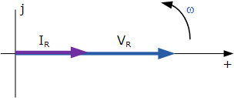
Continued….
From current equation (2), we conclude that:
The current flowing through a purely resistive ac circuit is sinusoidal.
The current through the resistive circuit and the applied voltage are in phase with each other.
Phasor Diagram:
The phasor diagram for a purely resistive ac circuit is as shown in fig. 1(c).
Fig. 1(c): phasor diagram

Slide 71
Continued….
Impedance of the purely resistive circuit:
The impedance Z is expressed in the rectangular form as:
Z = R + jX
where R is the resistive part while X is the reactive part.
When the load is purely resistive, the reactive part is zero.
∴ Z = R Ω
In the polar form it is given by,
Z = R ∠ 0⁰ Ω

Slide 72
Continued….
Average Power (P_{av}):
The average power supplied by the source and consumed by the pure resistor R connected in an AC circuit is given by,
P_{av} = V_{RMS} I_{RMS} ……. (3)
Energy in purely resistive circuit:
In the pure resistive circuits, the energy flow is unidirectional i.e. from the source to the load.
The resistance can not store any energy. So all the energy gets dissipated in the form of heat, in the resistance.
This fact is utilized in the electric heaters, water heaters and electric irons.

Slide 73
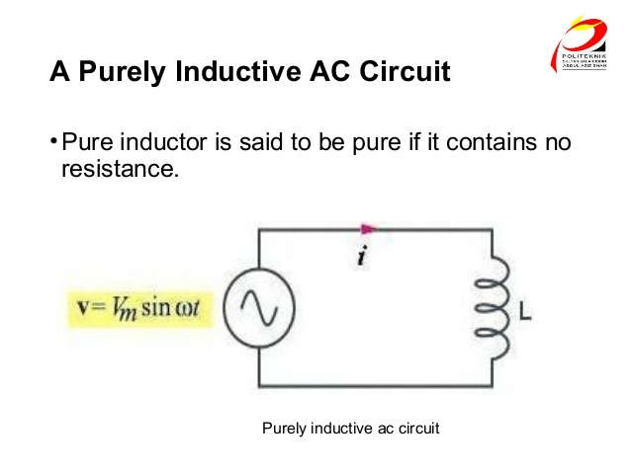
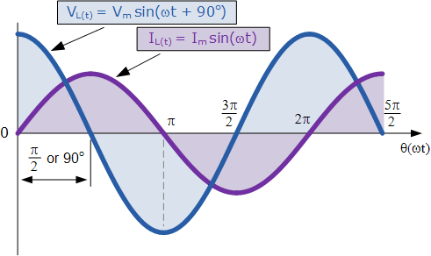
Purely Inductive AC Circuit
Fig. 1(a). shows a purely inductive ac circuit.
The pure inductance has zero ohmic resistance. It is a coil with only pure inductance of L Henries (H).
Fig. 1(a): A purely inductive ac circuit
Fig 1(b): current and voltage waveform

Slide 74
Continued….
Equations for Current i and Voltage v:
Let the instantaneous voltage applied to the purely inductive ac circuit be given by,
v = V_{m} sin (2πft) ……(1)
As shown in fig. 1(b), the instantaneous current is given by,
i = I_{m} sin (2πft – π/2) ……(2)
where I_{m} = V_{m} , X_{L} = reactance of inductor.
X_{L}

Slide 75
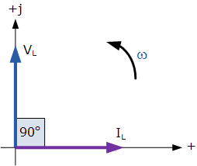
Continued….
From eq.(1) & (2), we conclude that,
Current lags behind the applied voltage by 90⁰ or π/2.
If we assume the current to be reference, the voltage across the inductance leads the current through it by 90⁰ or π/2.
Phasor Diagram:
Fig. 1(c): Phasor Diagram

Slide 76
Continued….
Power in Purely Inductive Circuit:
Instantaneous power (P):
The instantaneous power is given by the instantaneous voltage across the inductance and the instantaneous current through it.
∴ p = v x i
It can be proved that the instantaneous power in purely inductive circuit is given by,
p = - Vm Im x sin (2ωt)
2

Slide 77
Continued….
2. Average power:
The average power supplied to or consumed by a pure inductor connected in an ac circuit is zero.
∴ P_{av} = 0
Impedance of a purely inductive circuit:
When circuit is purely inductive, the resistive part is zero i.e. R = 0.
∴ Z = j X_{L} Ω
In polar form, it is given by,
Z = X_{L} ∠ 90⁰ Ω

Slide 78
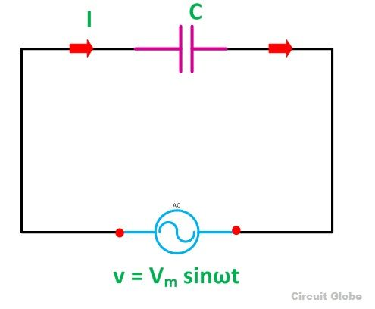
Purely Capacitive AC Circuit
The fig. 1(a) shows the purely capacitive AC circuit.
A pure capacitor has its leakage resistance equal to infinity.
Fig. 1(a): A purely Capacitive Circuit

Slide 79
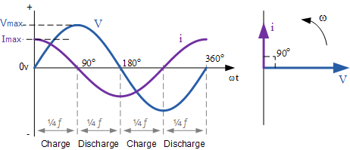
Continued….
Current and Voltage Waveforms and Phasor Diagram:
Fig. 1(b): Current & voltage waveform Fig. 1(c): Phasor Diagram

Slide 80
Continued….
Equations for current & voltage:
Let instantaneous voltage can be given by,
v = V_{m} sin (2πft) …..(1)
Then from fig. 1(b), instantaneous current is given by,
i = I_{m} sin (2πft + π/2) ……(2)
where I_{m} = V_{m} , X_{C} = reactance of capacitor.
X_{C}

Slide 81
Continued….
From eq.(1) & (2), we conclude that,
Current lags behind the applied voltage by 90⁰ or π/2.
If we assume the current to be reference, the voltage across the inductance leads the current through it by 90⁰ or π/2.

Slide 82
Continued….
Power in Purely Capacitive Circuit:
Instantaneous power (P):
The instantaneous power is given by,
p = v x I
It can be proved that the instantaneous power in purely capacitive circuit is given by,
p = - Vm Im x sin (2ωt)
2

Slide 83
Continued….
2. Average power:
The average value of power supplied to and consumed by a pure capacitor connected in an AC circuit is zero.
Impedance of a purely capacitive circuit:
When circuit is purely capacitive, the resistive part is zero i.e. R = 0.
∴ Z = - j X_{C} Ω
In polar form, it is given by,
Z = X_{L} ∠ -90⁰ Ω

Slide 84
AC Circuits with Series Elements

Slide 85
The Series R-L Circuit
Fig. 1 shows the series R-L circuit. AC voltage source of instantaneous voltage v = V_{m} sin(ωt) is connected across the series combination of L and R.
Assume that the current flowing through L and R is I amperes, where I is the rms value of the instantaneous current i.
Due to this current, the voltage drop across L and R are given by:
voltage drop across R, V_{R} = I. R (V_{R} is in phase with I)
voltage drop across L, V_{L} = I. X_{L} (V_{L} leads I by 90⁰)

Slide 86
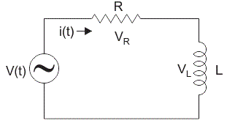
Continued….
Voltage and current are in phase
Voltage across L leads current by 90⁰
Fig. 1: R-L series circuit

Slide 87
Continued….
Phasor Diagram:
The applied voltage v is equal to the phasor addition of V_{R} and V_{L}.
V = V_{R} + V_{L} …..(phasor addition) …(1)
Substituting, V_{R} = IR and V_{L} = IX_{L} we get,
V = IR + IX_{L} …..(2)
This addition and voltage triangle is shown in fig. (2).

Slide 88
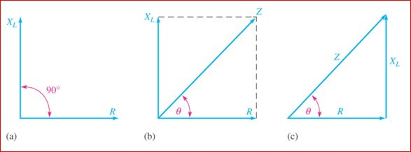
Continued….
Fig. (2): Phasor diagram and voltage triangle for RL series circuit

Slide 89
Continued….
Impedance of R-L series circuit:
the impedance of R-L series circuit is expressed in the rectangular form as,
Z = R + jX_{L} .....(3a)
And it is expressed in polar form as,
Z = |Z| ∠ ø …...(3b)
where |Z| = √(R² + X_{L}²) and ø = tan⁻¹[X_{L}/R]

Slide 90
Continued….
Voltage and current waveform:
from phasor diagram fig (2), it is evident that supply voltage v leads current i by a phase angle ø or current lags behind voltage by ø.
Hence the expressions for the voltage and current are as follows,
i = I_{m} sin (ωt- ø), and v = V_{m} sin (ωt).

Slide 91
Continued….
Fig. 3: voltage and current waveform

Slide 92
Continued….
Expression for current:
The current through R-L circuit is given by,
i(t) =
V(t)
V ∠ 0⁰
V ∠ -ø
=
=
Z
|Z| ∠ ø
|Z|
Let, V = I_{m} ∴i(t)=I_{m} ∠ -ø Amp
|Z|
Let, v = V_{m} sin (ωt). Hence the expression for the instantaneous current is,
i = I_{m} sin (ωt- ø)

Slide 93
Continued….
Average Power in Series L-R Circuit:
If we represent the rms voltage and current by V and I then, the average power supplied to a series RL circuit is given by,
P_{av} = VI cos ø Watts ….(4)
The average power supplied to the R-L circuit is,
P_{av} = (Average power consumed by R)
+ (Average power consumed by L)
But the average power consumed by pure inductance is zero.
∴ P_{av} = Average power consumed by R

Slide 94
The Series R-C Circuit
Fig. 1 shows the series R-C circuit. AC voltage source of instantaneous voltage v = V_{m} sin(ωt) is connected across the series combination of C and R.
Assume that the rms value of current flowing through C and R be equal to I amperes, the voltage drop across C and R are given by:
voltage drop across R, V_{R} = I. R (V_{R} is in phase with I)
voltage drop across C, V_{C} = I. X_{C} (V_{C} lags I by 90⁰)

Slide 95
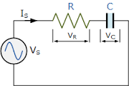
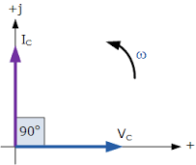
Continued….
Voltage and current are in phase
Voltage across capacitor lags current
Fig. 1: R-C series circuit

Slide 96
Continued….
Phasor Diagram:
The applied voltage v is equal to the phasor addition of V_{R} and V_{C}.
V = V_{R} + V_{C} …..(phasor addition) …(1)
Substituting, V_{R} = IR and V_{C} = IX_{C} we get,
V = IR + IX_{C}
∴ V = √(IR)² + (IX_{C})² …..(2)
∴ V = I √(R)² + (X_{C})² …..(3)
Let |Z| = √R² + X_{C}²
∴ V = I. |Z| ….(4)

Slide 97

Continued….
Fig. (2): Phasor diagram and voltage triangle for RC series circuit

Slide 98
Continued….
Impedance of R-C series circuit:
the impedance of R-C series circuit is expressed in the rectangular form as,
Z = R - jX_{C}
And it is expressed in polar form as,
Z = |Z| ∠ -ø
where |Z| = √(R² + X_{C}²) and ø = tan⁻¹[-X_{C}/R]
The phase angle is negative for capacitive load.

Slide 99
Continued….
Voltage and current waveform:
from phasor diagram fig (2), it is clear that supply voltage v lags behind current i by a phase angle ø or current leads voltage by ø.
Hence the expressions for the voltage and current are as follows,
i = I_{m} sin (ωt + ø), and v = V_{m} sin (ωt).

Slide 100
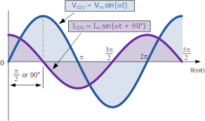
Continued….
Fig. 3: voltage and current waveform

Slide 101
Continued….
Voltage and current equations:
Let the applied voltage be
v(t) = V_{m} sin (ωt) = Vm ∠ 0⁰ volts
The impedance of an RC series circuit is,
Z = R – jX_{C} = |Z| ∠ -ø
then the instantaneous current is expressed as,
It shows that the current leads the applied voltage vy an angle ø.
i = I_{m} sin (ωt + ø),

Slide 102
Continued….
Average Power in Series L-C Circuit:
If we represent the rms voltage and current by V and I then, the average power supplied to a series RC circuit is given by,
P_{av} = VI cos ø Watts ….(4)
The average power supplied to the R-L circuit is,
P_{av} = (Average power consumed by R)
+ (Average power consumed by C)
But the average power consumed by pure capacitance is zero.
∴ P_{av} = Average power consumed by R

Slide 103
Three Phase Supply

Slide 104
Introduction to Polyphase AC Circuits
The domestic ac supply is single phase ac supply with 230V/50Hz.
But this ac supply is not suitable for certain applications. Some need a polyphase ac supply.
Polyphase ac supply is the one which produces many phases simultaneously.

Slide 105
Continued….
How to generate a polyphase ac supply?
The single phase ac voltage is generated by using a single phase alternator. Single phase alternator consists of only one armature winding.
But in order to generate a polyphase voltage, we have to use many armature winding. The number of windings is equal to the number of phases.

Slide 106
Three Phase Supply waveforms
A three phase system has proved to be the most economical as compared to the other systems. Hence in practice the three phase systems is most preferred.
The three armature windings used for generation of a three phase supply are located at 120⁰ away from each other.
The voltages induced in these windings are of same amplitude and frequency, but they are displaced by 120⁰ with respect to each other as shown in fig.(1).

Slide 107
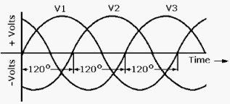
Continued….
fig.(1): Three phase voltage waveform

Slide 108
Advantages of Three Phase Systems over Single Phase System
More output
Smaller size
Three phase motors are self starting
More power is transmitted

Slide 109
Comparison of Single Phase & Three Phase Systems
Sr. No. | Parameter | Single phase system | Three phase system
1. | Voltage | Low(230 V) | High (415V)
2. | Transmission efficiency | Low | High
3. | Size of machines to produce same output | Larger | Smaller
4. | Cross sectional area of conductors | Large | Small
5. | Usage | Domestic, small power applications | Industrial, large power applications

Slide 110
Three Phase Emf Generation & its Waveform
Principle:
The single phase supply is generated using a single turn alternator.
Thus if armature consists of only one winding, then only one alternating voltage is produced.
But if the armature winding is divided into three groups which are displaced by 120⁰ from each other, then it is possible to generate three alternating voltages.

Slide 111
Continued….
Construction:
As shown in fig.(1) the armature winding is divided into three groups. The three coils are R-R’, Y-Y’ and B-B’.
All these coils are mounted on the same shaft and are physically placed at 120⁰ from each other.
When these coils rotate in the flux produced by the permanent magnet, emf in induced into these coils. As shown in fig.(2), these emf are sinusoidal, of equal amplitudes and equal frequency but they are displaced from each other by 120⁰.
V_{R}, V_{Y} and V_{B} are three phase voltages.

Slide 112
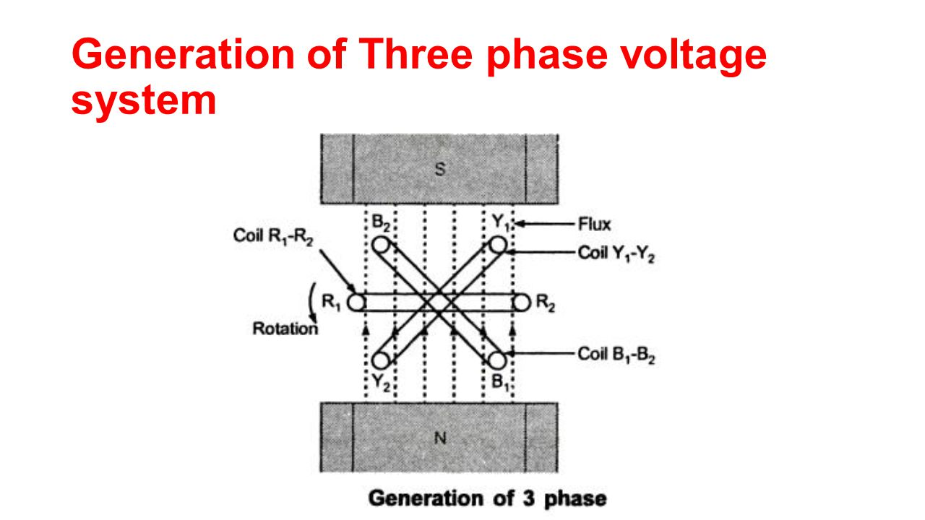
Continued….
Fig.(1): Generation of a 3-phase voltages

Slide 113
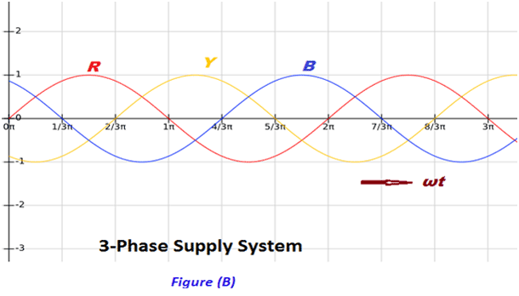
Continued….
Fig.(2): Voltages induced in the three coils

Slide 114
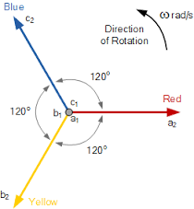
Continued….
If V_{R} is considered as the reference, then we conclude that,
V_{Y} lags V_{R} by 120⁰.
V_{B} lags V_{Y} by 120⁰.
In other words, V_{B} lags V_{R} by 240⁰.
Fig.(3): Phasor representation of the three phase voltages

Slide 115
Continued….
Mathematical representation:
The mathematical expression for the three induced voltages are given by:
V_{R} = V_{m} sin ωt
V_{Y} = V_{m} sin (ωt-120⁰)
V_{B} = V_{m} sin (ωt-240⁰) = V_{m} sin (ωt+120⁰)

Slide 116
Continued….
Phase sequence:
The phase sequence is defined as the sequence in which the three phases reach their maximum values. Normally the phase sequence is R-Y-B.
Importance of phase sequence:
The direction of rotation of three phase machines depends on the phase sequence.
If the phase sequence is changed e.g. R-B-Y then the direction of rotation will be reversed.
In order to avoid such things, the phase sequence of R-Y-B is always maitained.

Slide 117
Three Phase supply Connection
In three phase ac system, the three phase alternator has three separate windings one per each phase.
Hence the power generated in each phase can be transmitted independently to the load using 2 wires per winding. But this will requires 6- different wires.
Eventhough such a system is practically possible, it makes the system complicated and expensive.
Hence in practice, the three windings of the alternator are interconnected in two different ways to reduced the number of wires required for the connections

Slide 118
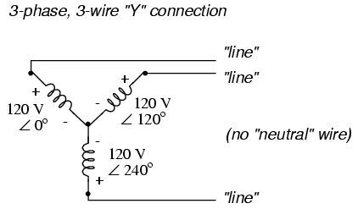
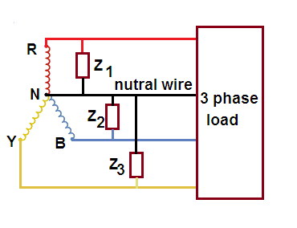
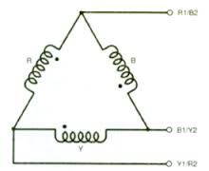
Continued….
Types of connection
Three phase three wire star (wye) connection
Three phase four wire star connection
Three phase three wire delta connection

Slide 119
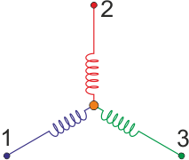
Star Connection(wye connection)
This configuration is obtained by connecting one end of the three phase winding together.
We can connect either R Y B or R’ Y’ B’ together. This common point is called as the Neutral Point.
R
V_{Ph}
Terminals brought out for external connection
R’
Y’
B’
Y
B
N

Slide 120
Delta Connection
Delta or mesh configuration is obtained by connecting one end of winding to the starting end of the other winding such that it produces a closed loop.

Slide 121
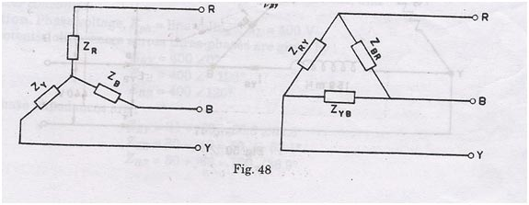
Types of Loads
The two types of load connection are:
Star connection of load
Delta connection of load
Fig. (1): types of loads

Slide 122
Continued….
Balanced load:
A balanced load is that in which magnitudes of all impedances connected in the load are equal and the phase angles of them also are equal and of same type (inductive, resistive or capacitive).
Unbalanced load:
If load doesn’t satisfy the condition of balanced, then it is called as the unbalanced load.
The magnitudes and phase angles of the unbalanced loads are differ from each other.

Slide 123
Balanced Star Load
Line voltages & Phase voltages:
Line voltage:
If R, Y and B are called as the supply lines, then the potential difference between any two lines is known as the line voltage.
V_{RY}, V_{RB}, V_{YB}, V_{YR}, V_{BR} and V_{BY} are six possible line voltages.
All the line voltages are sinewaves of 50 Hz frequency and the phase shift between the adjacent line voltage is 60⁰.

Slide 124
Continued….
Phase voltages:
the voltage measured across a single winding or phase is called as phase voltage.
All the phase voltages are sinewaves and the phase difference between the adjacent phase voltages is 120⁰.

Slide 125
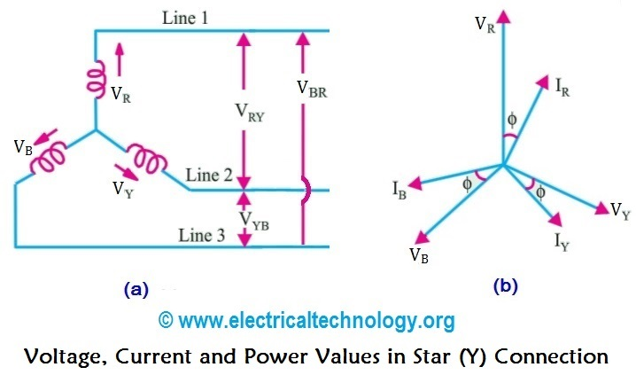
Continued….

Slide 126
Continued….
Relation between line and phase voltages:
In the star connected system, the line voltage is higher than the phase voltage by factor √3.
∴ line voltage = √3 phase voltage.
Phase current:
The current passing through any branch of the star connected load is called as the phase current. It is denoted by Iph.
Line current:
The current passing through any line R, Y, B is called as the line current. It is denoted by IL.
For star connected load I_{L} =I_{ph}.

Slide 127
Continued….
Equations for three phase power:
In single phase ac circuit, the power consumed in each phase is given by,
P_{ph} = V_{ph} I_{ph} cos ø ….(1)
where ø = angle between V_{ph} and I_{ph}
For balanced three phase system, the total power consumed will be given by,
P_{T} = 3 P_{ph} = 3 V_{ph} I_{ph} cos ø …..(2)
here V_{ph} = RMS phase voltage
I_{ph} = RMS phase current
substituting V_{ph} = V_{L}/√3 and I_{ph} = I_{L}, we get,
Total power P_{T} = 3 x V_{L}/√3 x I_{L} cos ø
∴ P_{T} = √3 V_{L} I_{L} cos ø …..(3)

Slide 128
Continued….
Power factor for a star load:
The load power factor for a 3 phase balanced star load is equal to the power factor of each phase in the load.
∴ overall P.F. = cos ø
where ø = angle between the phase voltage and phase current

Slide 129
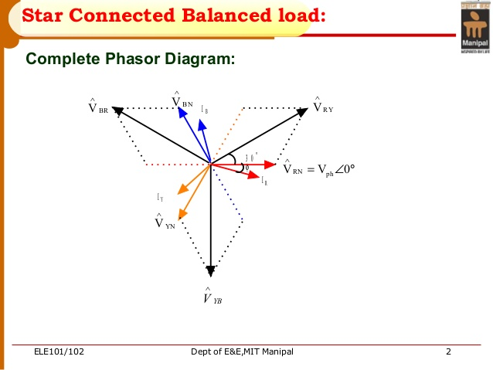
Continued….
The complete phasor diagram:

Slide 130
Continued….
Conclusion from the phasor diagram:
Phase currents lags behind the corresponding phase voltages by ø radians respectively as the load is inductive.
The line voltages are displaced by 120⁰ from each other.
The line voltages leads their respective phase voltages by 30⁰.

Slide 131
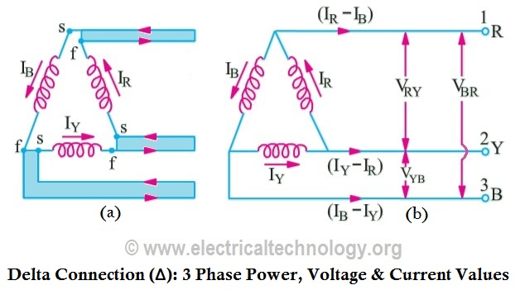
Balanced Delta Load

Slide 132
Continued….
For delta connection,
line voltage = phase voltage
Here, line current is higher than phase current.
I_{L} = √3 I_{ph}
The total power consumed for delta connected load is same as that for the star connected load.
Power factor:
overall P.F. = cos ø

Slide 133
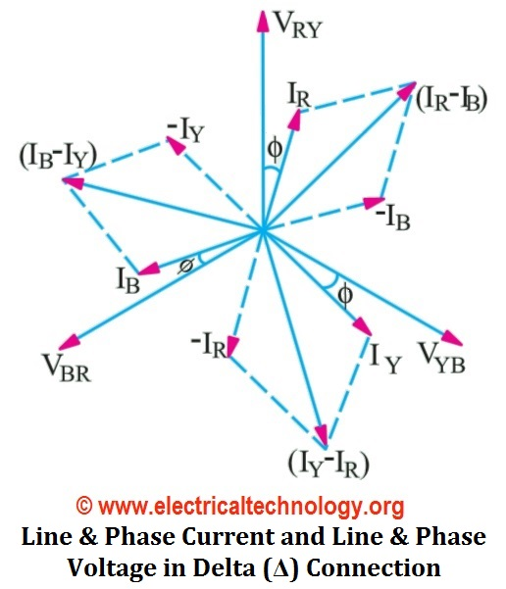
Continued….
The complete phasor diagram:

Slide 134
Continued….
Conclusion from the phasor diagram:
Phase currents lags behind the corresponding phase voltages by ø radians respectively as the load is inductive.
Every line current lags the respective phase current by 30⁰.

Slide 135
Types of Power
Different types of powers are-
Apparent power S (volt ampere VA)
Active power P (watts)
Reactive power Q (volt ampere VAR)
All these are applicable to the three phase circuits as follows:
Total apparent power S = 3 x apperent power per phase
∴ S= 3 x V_{ph} x I_{ph} = 3 xV_{L}/√3 xI_{L} ….for star load
∴ S = √3 V_{L} I_{L} (VA or kVA) ….for star load

Slide 136
Continued….
S = 3 V_{L} x I_{L}/√3 …..for delta load
∴ S = √3 V_{L} I_{L} (VA or kVA) ….for delta load
Total Active Power P = 3 x Vph x Iph x cos ø
= 3 V_{L}/√3 x I_{L} cos ø
= 3 V_{L} x I_{L} /√3 cos ø
∴ P = √3 V_{L} I_{L} cos ø watt ….(star or delta load)
Total Reactive Power Q = 3 V_{ph} x I_{ph} sin ø
∴ Q = 3 V_{L} x I_{L} sin ø VAR or kVAR
….(star or delta load)

Slide 137
Continued….
Power Triangle:
fig,.(1)shows the power triangle for a 3-phase system.
(Apparent Power) = [(Active power)² + (Reactive Power)²]
S = √P² +Q2
Power Factor:
the overall power factor of a three phase system is defined as the cosine of the angle between the phase voltage and phase current.

Slide 138
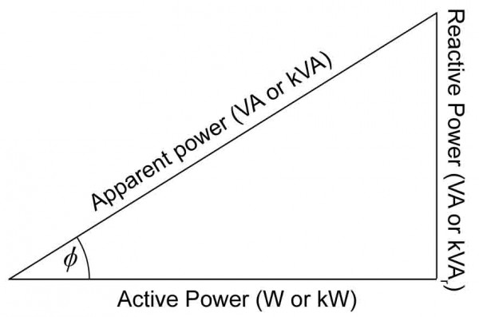
Continued….
Fig.(1): power triangle for a three phase system

Slide 139
Comparison of star & delta connection
Sr.No. | Parameter | Star connection | Delta connection
1. | Connection | See fig.(a) | See fig.(b)
2. | Neutral point | Present | Absent
3. | Relation between phase and line voltages | V_{L} = √3 V_{ph} | V_{L} =V_{ph}
4. | Relation between phase and line currents | I_{L} = I_{ph} | I_{L} = √3 I_{ph}
5. | Total active power | P = √3 V_{L} I_{L} cos ø | P = √3 V_{L} I_{L} cos ø
6. | Total reactive power | Q = √3 V_{L} I_{L} sin ø | Q = √3 V_{L} I_{L} sin ø

Slide 140
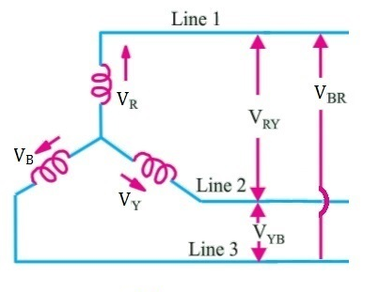
Continued….
Fig.(a): star connection
Fig.(b): delta connection

Slide 141
Applications of 3 Phase AC Circuits
3 phase induction motors.
3 phase synchronous motors.
Submersible water pumps.
Various machines-tool applications (lathe machine, grinder, milling machine etc.)
Large factories and educational institutions.

